Slide 1
How to Have a Successful Bar/Nightlife Business in Nashville, TN
Group 3

Slide 2
Introduction
Location: Nashville, Tennessee
Types of Business: Bars or Nightlife
Definition of Success: Star rating on Yelp

Slide 3
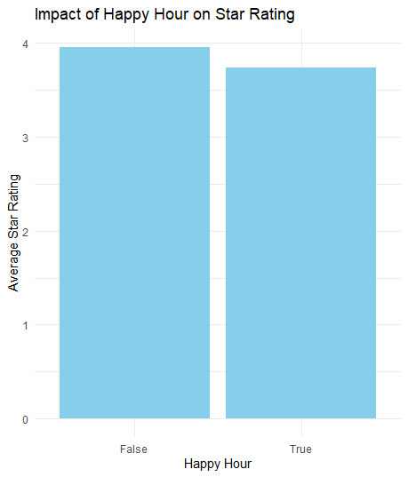
Happy Hours are not important
The star difference between businesses who don’t have happy hours and those that do is less less 0.5 stars. To verify this we used a two-sample t-test.

Slide 4
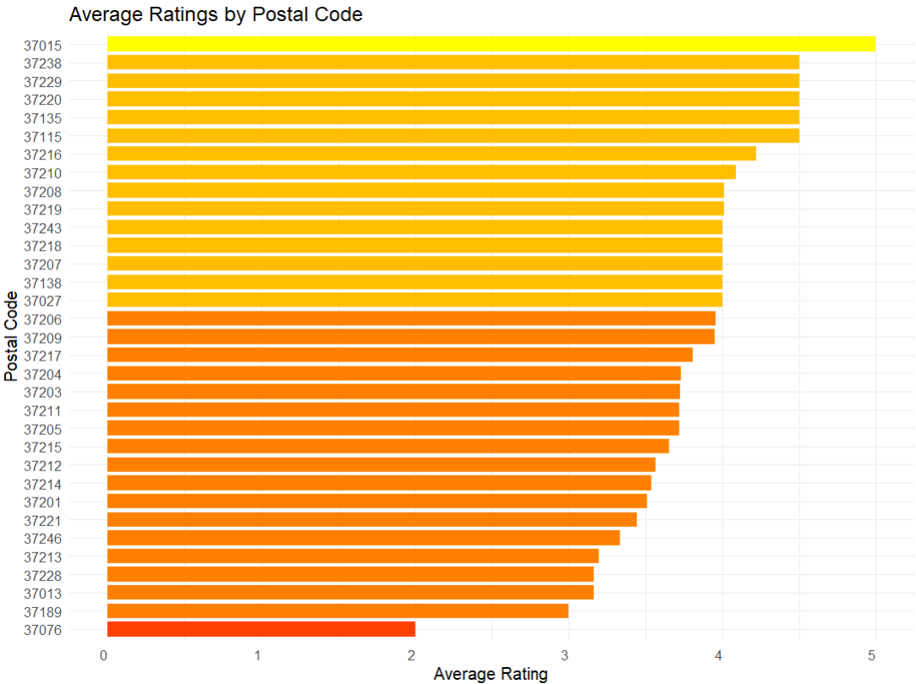
2. Location is important
The differences between star rating between postal codes is significance as discovered through an ANOVA test. We advise to have a business in 37216 over 37221 based on results from our analysis.

Slide 5
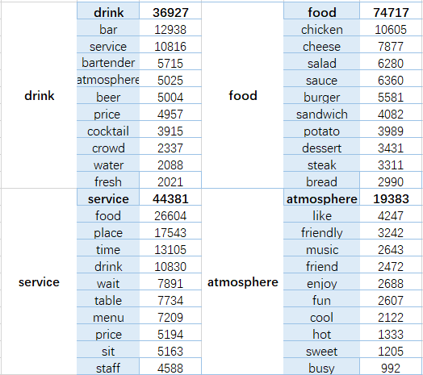
3. What matters to the customer: Reviews
We suggest focusing on top mentioned words in customer reviews. When talking about drink, customers care about bartender, atmosphere and price. The most popular category of food is chicken. When talking about service, food, place, time and drink are mostly mentioned. Customers tend to write reviews for a business when the atmosphere is friendly.

Slide 6
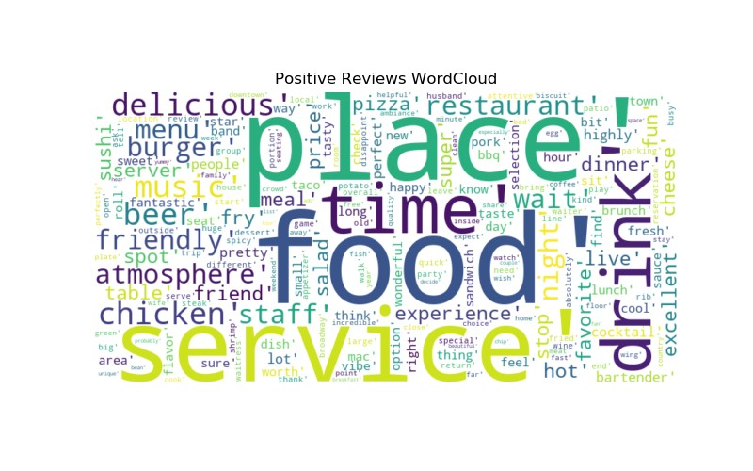
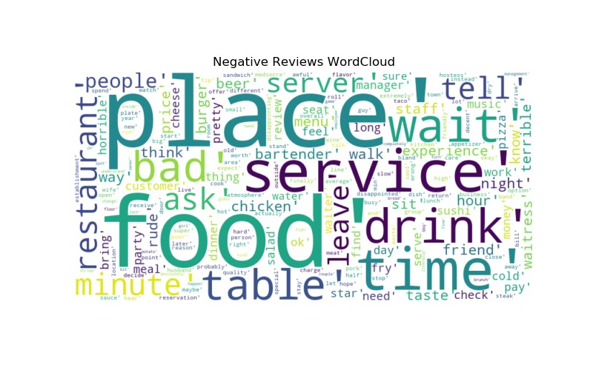
3. What matters to the customer: Reviews
We specifically suggest focusing on service, food, and time as these were the main words used in both positive and negative reviews by customers.

Slide 7
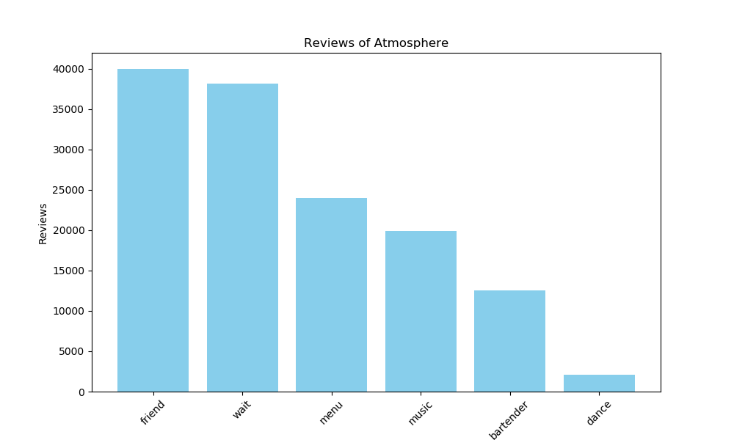
4. What matters to the customer: Atmosphere
Customers value friends (23.7% reviews mentioned) when entering the bar or nightlife business and are sensitive to wait (22.6% reviews mentioned). Thus we encourage you to focus on marketing towards people bringing friends and improving wait times.

Slide 8
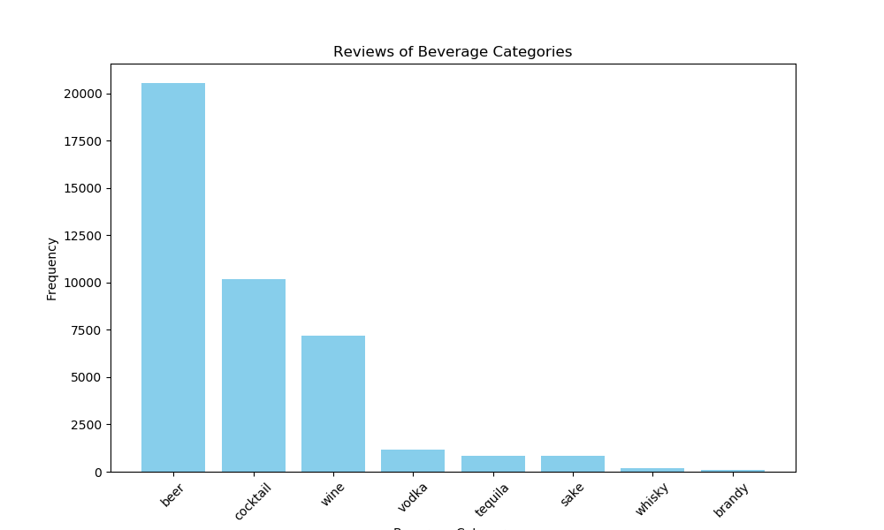
6. Cocktails are the best drink to serve
We suggest serving cocktails as those had the best sentiment score. Wine was the second best.

Slide 9
What aspects to focus on?
We suggest you to focus more on the service, quality of food and wait time to increase your star rating.
ASPECT | INCREASE IN SCORE | INCREASE IN STAR RATING
Service | 1 unit | 0.81
Time | 1 unit | 1.61
Food | 1 unit | 0.51

Slide 10
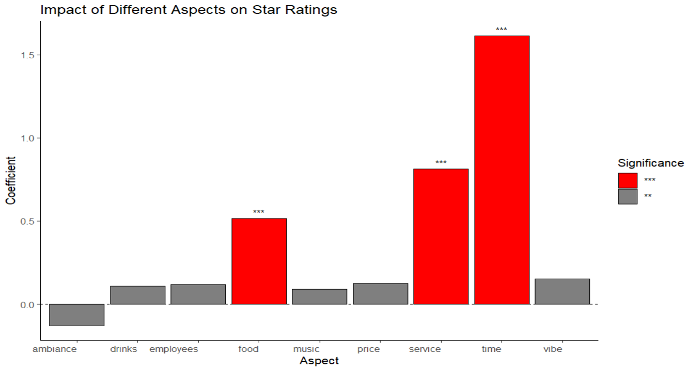

Slide 11
Shiny App
Bars and Nightlife in Nashville

